Slide 1
AI Agent for Digital Financial Literacy
CAPSTONE AICTE PROJECT
Presented By: VARAD FARTALE
Student name : VARAD FARTALE
College Name & Department : VSIT

Slide 2
OUTLINE
Problem Statement
Technology used
Wow factor
End users
Result
Conclusion
Git-hub Link
Future scope
IBM Certifications

Slide 3
Problem Statement
The Challenge:
In today's rapidly evolving digital economy, millions of individuals—especially in rural and underserved communities—struggle with understanding basic financial concepts such as budgeting, saving, digital payments, credit scores, and online banking. Despite growing access to mobile devices and the internet, the lack of personalized and interactive financial education tools remains a significant barrier to achieving inclusive financial well-being.

Slide 4
Technology used
IBM cloud lite services
Natural Language Processing (NLP)
Retrieval Augmented Generation (RAG)
IBM Granite model

Slide 5
IBM cloud services used
IBM Cloud Watsonx AI Studio
IBM Cloud Watsonx AI runtime
IBM Cloud Agent Lab
IBM Granite foundation model

Slide 6
Wow factors
The AI Agent for Digital Financial Literacy stands out through its ability to offer hyper-personalized financial education tailored to the user’s language, region, age, and financial behavior. It engages users through natural voice and chat interfaces in multiple Indian languages, making it accessible to people with low literacy or limited digital exposure. The agent understands user emotions through sentiment analysis and adjusts its communication style in real time to offer support and clarity when users are confused or hesitant.

Slide 7
End users
Rural farmers using smartphones for the first time
College students managing personal budgets
Small shop owners transitioning to digital payments
Homemakers exploring savings and investment options
Migrant workers sending money via UPI
Retired individuals learning to use online banking

Slide 8
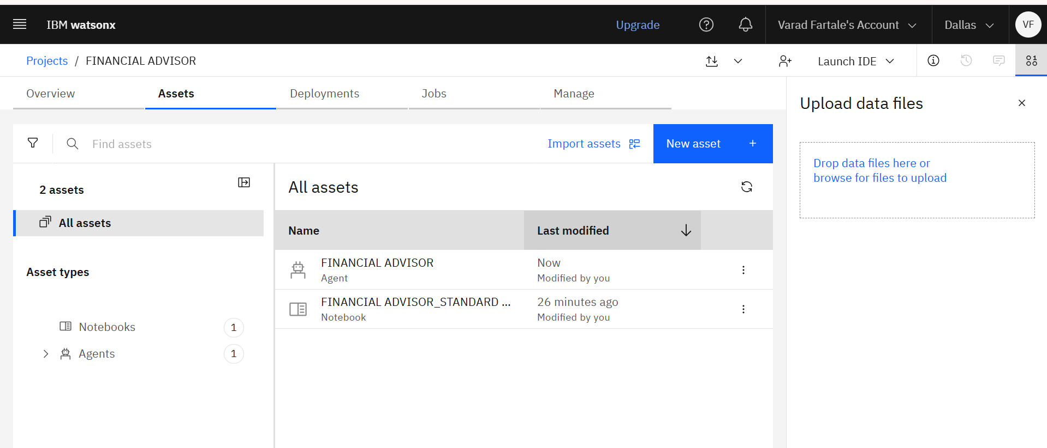
Results

Slide 9
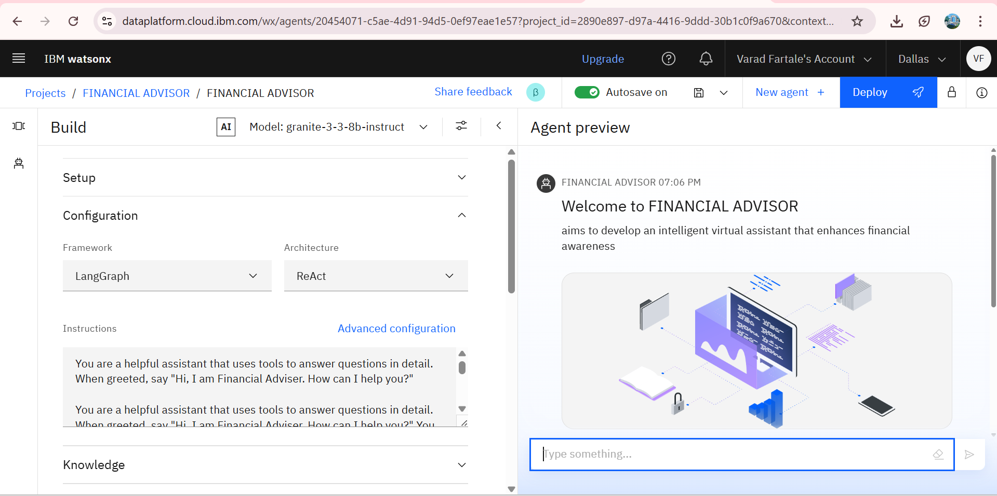
Results

Slide 10
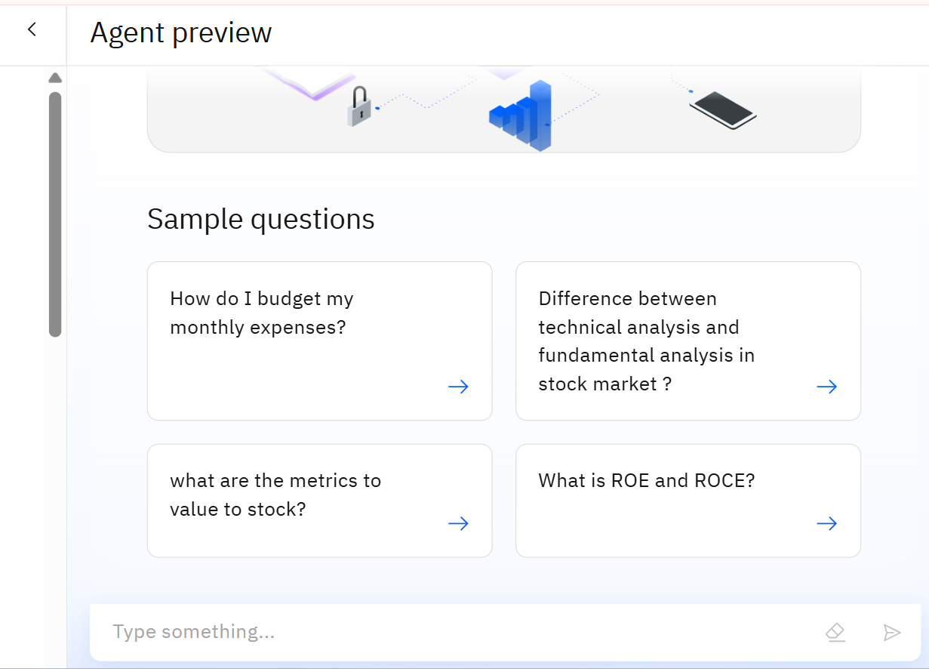
RESULTS

Slide 11
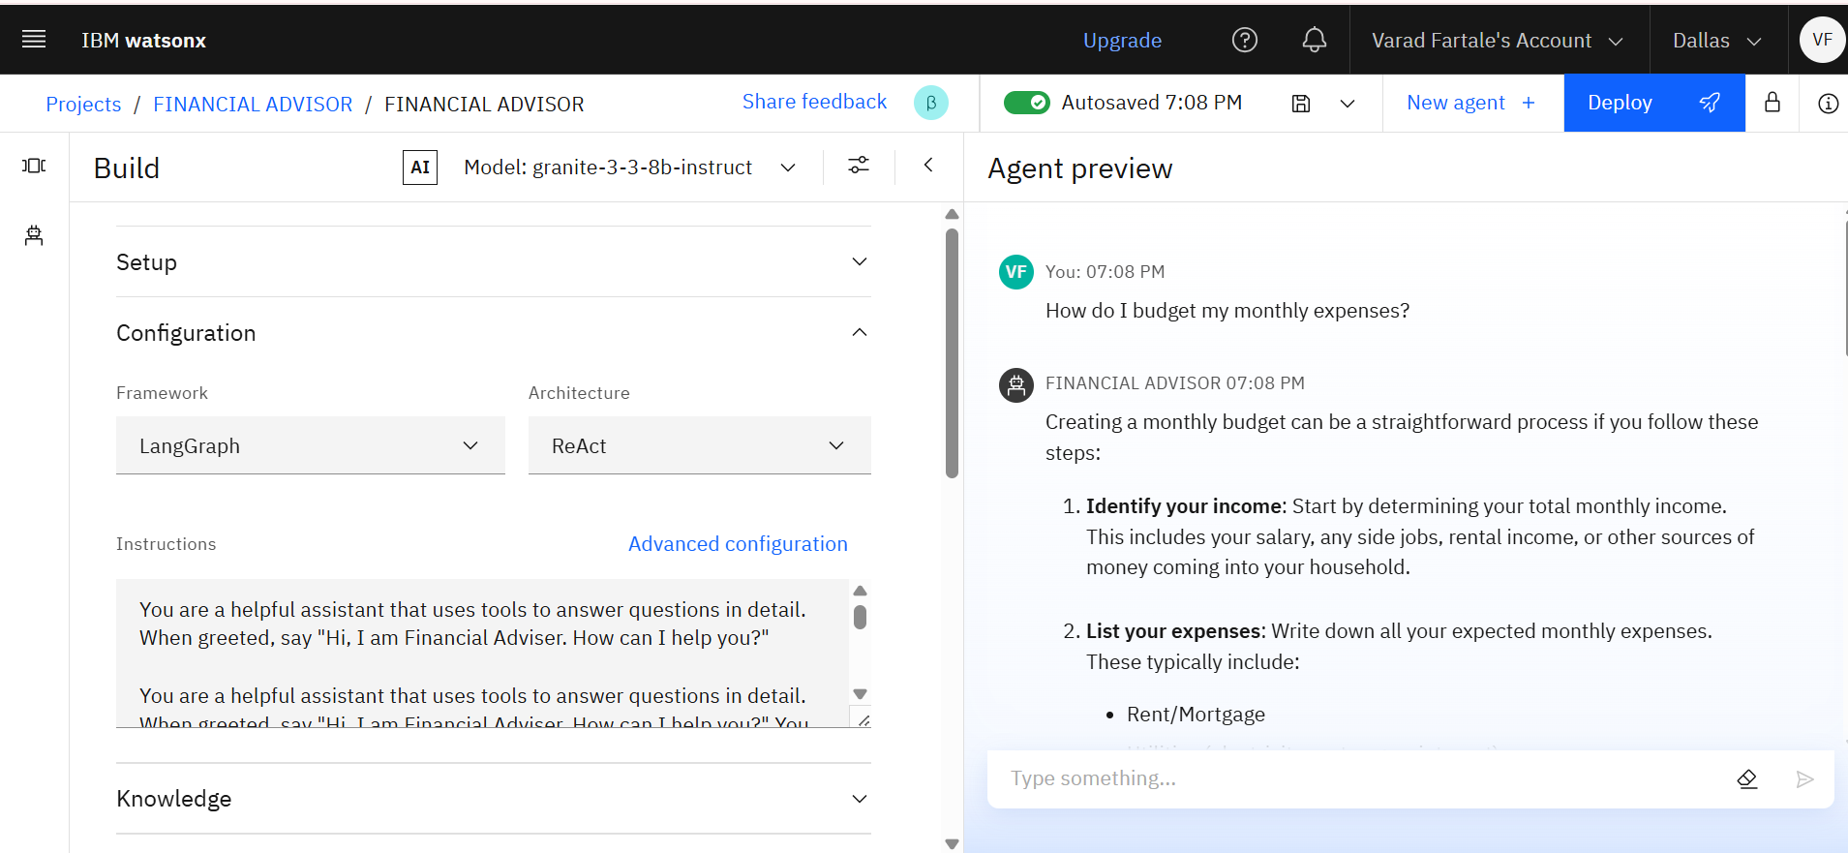
Results

Slide 12
Conclusion
The AI Agent for Digital Financial Literacy represents a transformative solution to bridge the financial knowledge gap in today's digital era. By combining AI-driven personalization, multilingual support, and real-time guidance, it empowers individuals from diverse backgrounds to make informed financial decisions. This agent not only simplifies complex financial concepts but also fosters confidence, security, and independence in managing personal finances. It stands as a step toward true financial inclusion, where technology enables equitable access to financial knowledge for all.

Slide 13
Future scope
Integration with Real Banking Systems
Advanced Fraud Detection
Voice-First & Multilingual Expansion
Virtual Financial Advisor Role
Gamified Financial Ecosystems
AI Model Continuous Learning

Slide 14
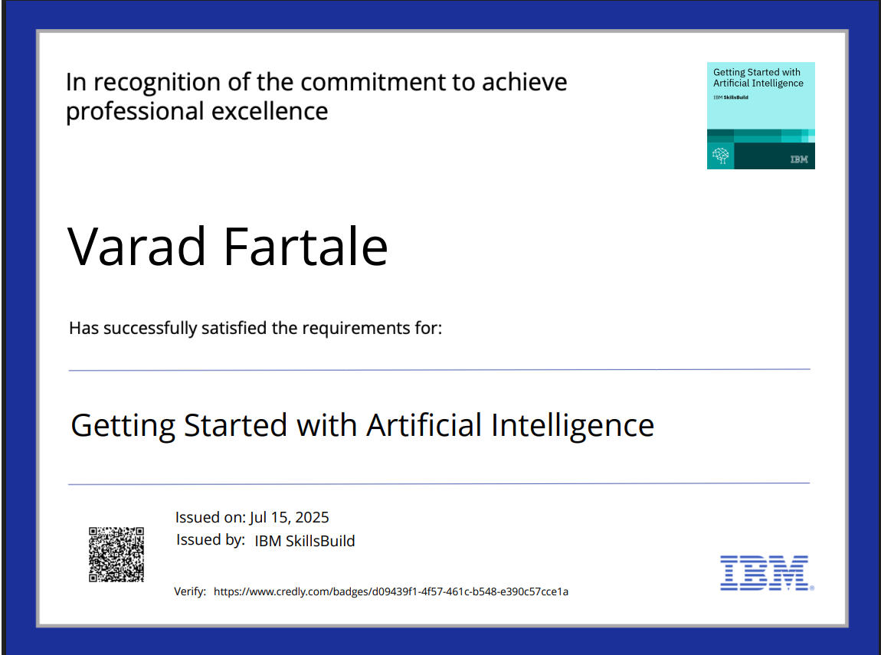
IBM Certifications

Slide 15
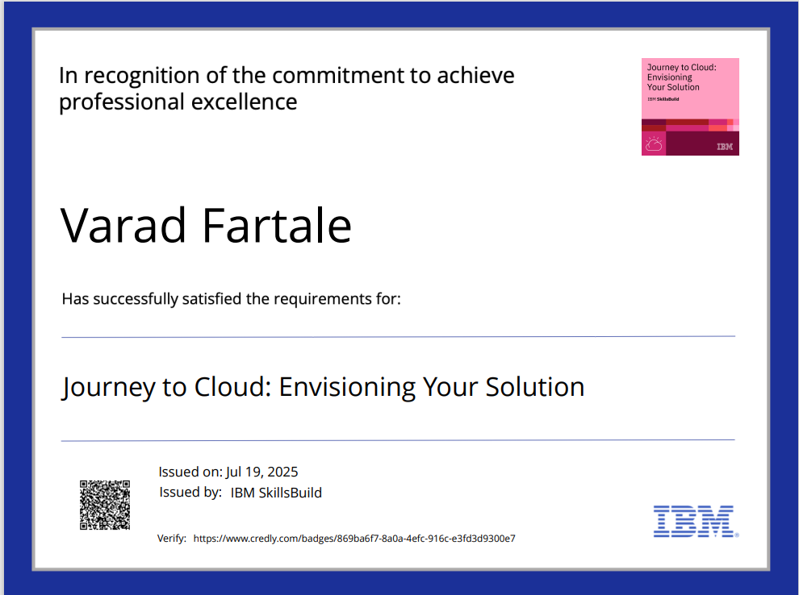
IBM Certifications

Slide 16
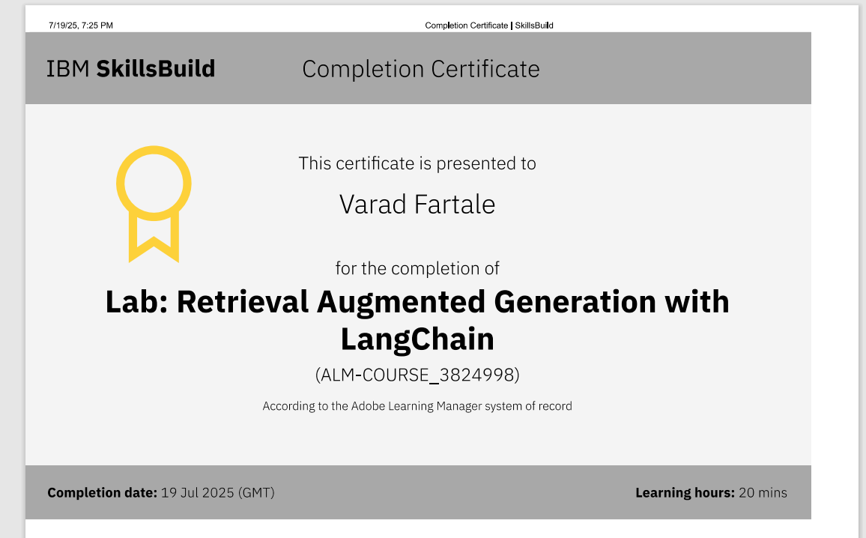
Attach your RAG LAB certificate here

Slide 17
GITHUB LINK :
https://github.com/varadfartale11/Financial-Adviser-Agent

Slide 18
THANK YOU

